Slide 1

OPTICAL CHARACTER RECOGNISATION

Slide 2
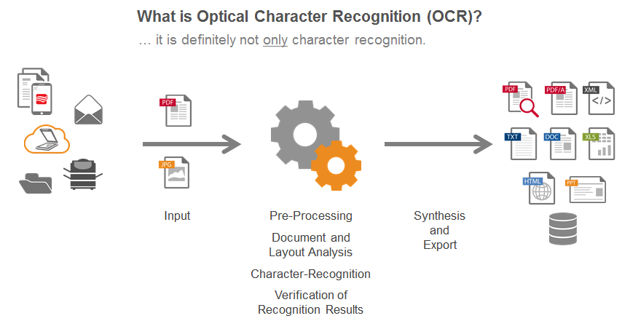

Slide 3
APPLICATIONS OF OCR
Banking
Legal
Healthcare
OCR in Other Industries
education
finance
government agencies

Slide 4
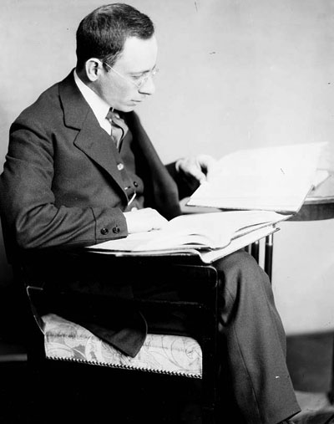
OCR INVENTION
In 1914, Emanuel Goldberg developed a machine that read characters and converted them into standard telegraph code
In 1931 he was granted USA Patent number 1,838,389 for the invention. The patent was acquired by IBM.

Slide 5
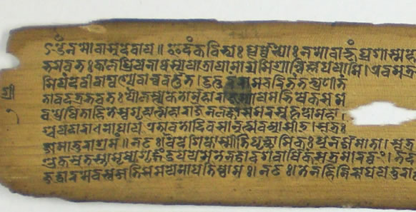
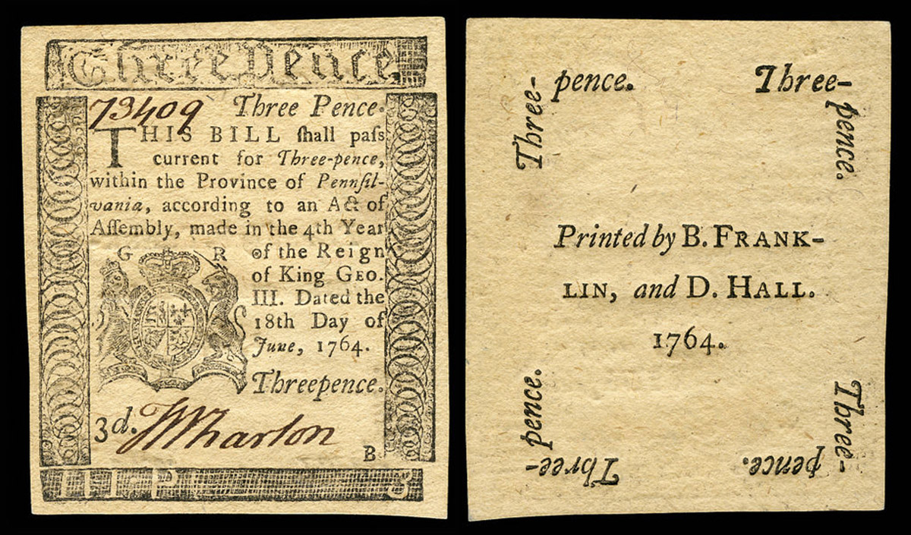
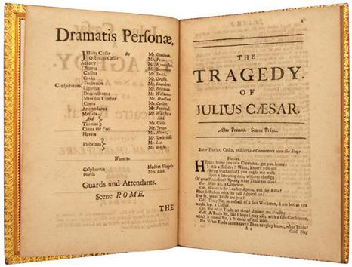
CHALLENGES IN OCR
The quality of optical character recognition (OCR) on historical texts is often surprisingly low.
Historical spelling variation represents a barrier for search even if texts are properly reconstructed.

Slide 6
ALGORITHMS USED
MARKOV(HMM)
BAYES THEORM

Slide 7

Probabilities:
initial probability $p(t_{1})$

Slide 8
PROBABILITIES
INITIAL PROBABILITIES
P(S1)(initial state distribution) that is the prior of "letter" at position 1—” startletterProbs{} ”
All letters positioned later the first letter with their probabilities—”allletterProbs{}”
Example:
In the middle of difficulty lies opportunity.
Letter at position one in the sentence : I
Letter positioned later to the Sentence: n

Slide 9
Transition Probability
Transition probabilities: Probability of 2 letters appearing in a sequence
P(Si+1|Si) = P(Si+1 , Si)/P(Si)
log(P(Si+1|Si)) = log(P(Si+1 , Si))-log(P(Si))
Example:
In the middle of difficulty lies opportunity.
P(Si+1|Si) = P(Si+1 , Si)/P(Si)
P(h/t)=P(h,t)/P(h)

Slide 10
Emission probabilities:
Emission probabilities:
P(Wi/Si):
P(Observed Character Image | letter)
It is considered as a lit pixel where there is '*'
It is considered as an unlit pixel where there is ‘ ‘

Slide 11
HMM
“The HMM is based on augmenting the Markov chain. A Markov chain is a model that tells us something about the probabilities of sequences of random variables, states, each of which can take on values from some set.”
Hidden States - Actual textual letters
Observed variables – Characters in images
A letter transition if it is not in the trained dictionary I substitute by small probability math.log

Slide 12
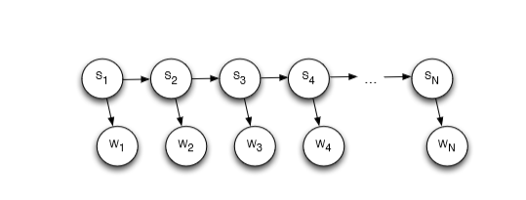
Hidden Markov Model
Each state is dependent on the previous state
So for sequence "s1,s2,s3,s4,....,sn"
Probability P(Si = si|W) leads to maximum
P(S1,S2,S3,S4,....,Sn/W1,W2,W3,...,Wn) = P(W1/S1)*P(S1)*P(W2/S2)*P(S2/S1)....*P(Wn/Sn)*P(Sn/Sn-1)
For every state at position t, find the max of previous states' probability times the transition probability from the precious state to current state and multiply with emission probability of the current state
maxPaths[position][POS] = maxPaths[position-1] [prevStateLeadingToMax] + "=>" + POS

Slide 13

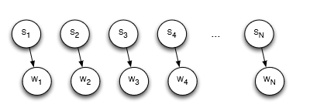
Bayes Approach
Assumption is that each POS at a give position is independent of any other positions.
That is, P(S1,S2,S3,S4,....,Sn/W1,W2,W3,...,Wn) =P(W1/S1)*P(S1)*P(W2/S2)*P(S2)....*P(Wn/Sn)*P(Sn)
So at every ith position, we find out the "si" leading to the highest probability of P(Si = si/W) and output the sequence of the labels.

Slide 14
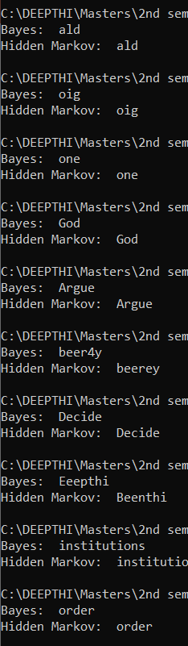
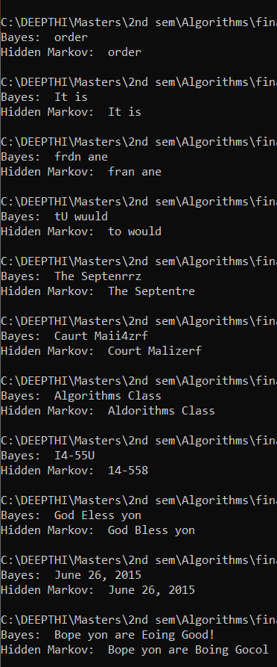
Results

Slide 15
GRAPHS

Slide 16
Graph

